Slide 1
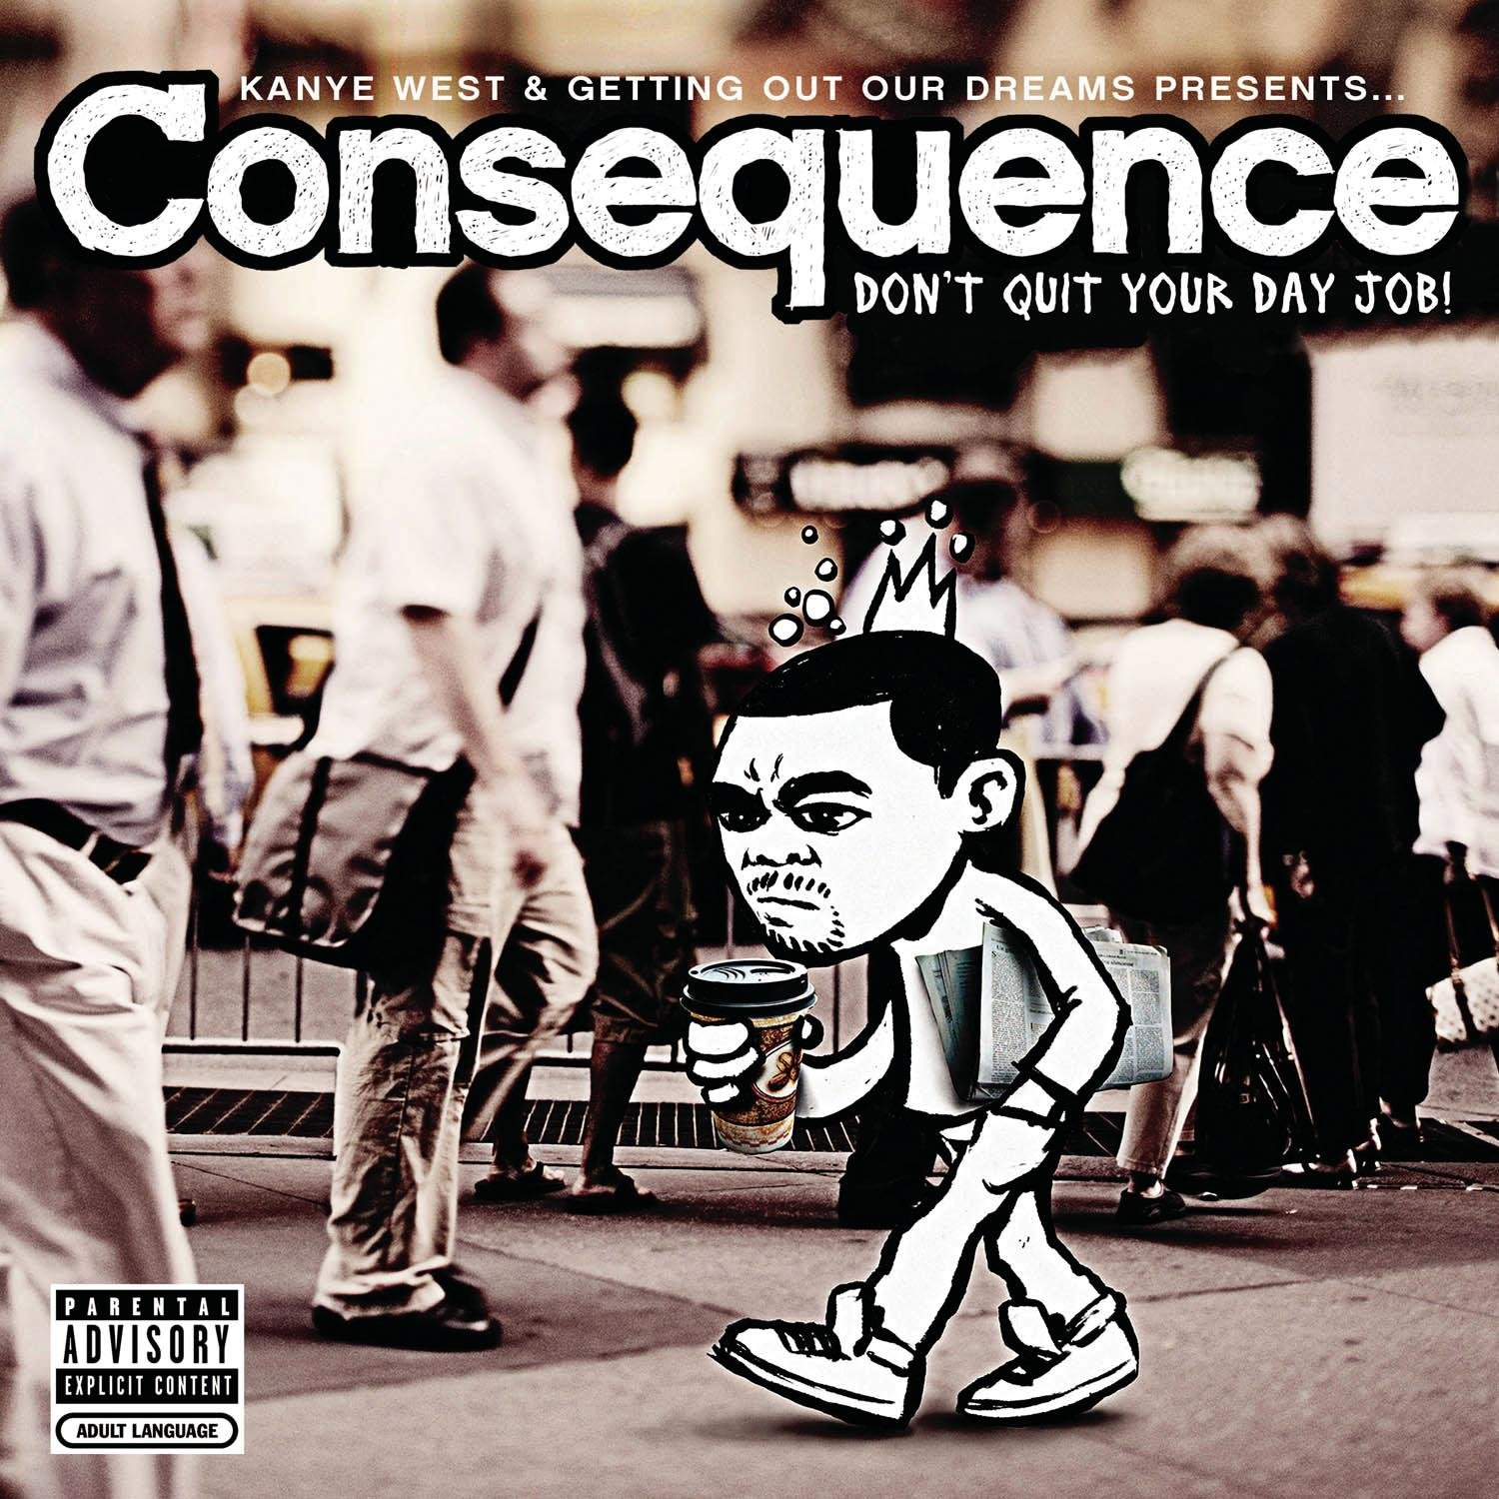
Reviews by Genre:
An Analysis of Album Ratings & Reviews
By Broderick Turner

Slide 2
Goals
Evaluate critical reception of albums
Determine differences in reviews across genres
Place these results into a greater context

Slide 3
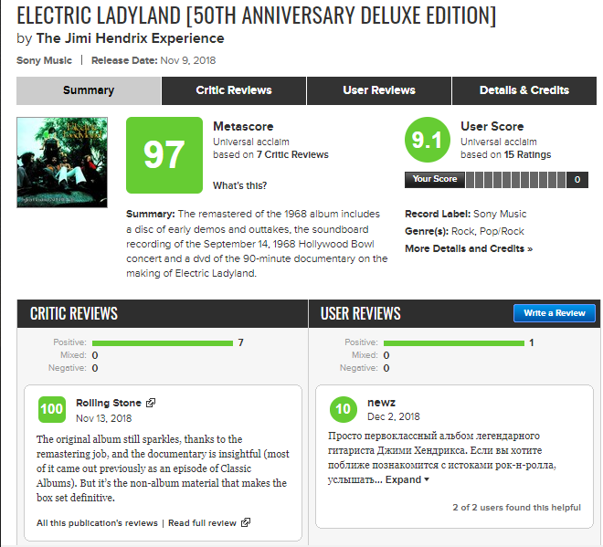
Presentation Title
Presentation Subtitle

Slide 4
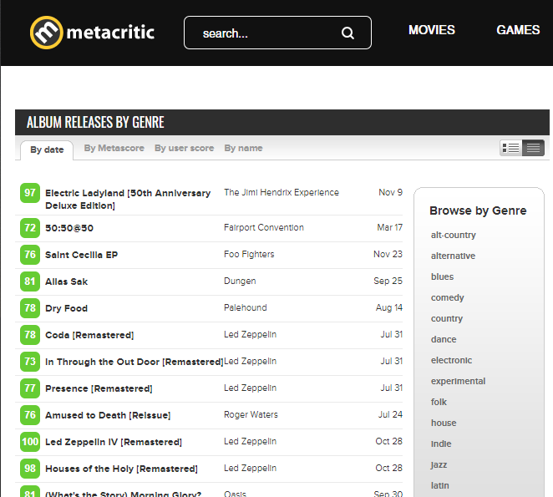
Presentation Title
Presentation Subtitle

Slide 5
Experiment Design
Based on Metacritic’s scoring, compare rap to other genres
H₀: The mean album review score from rap and each other genre, respectively, is the same
H_{A}: The mean album review score from rap and each other genre, respectively, is different
Welch’s t-test between rap and each other genre
α = 0.05
Bonferroni correction

Slide 6









Technology

Slide 7
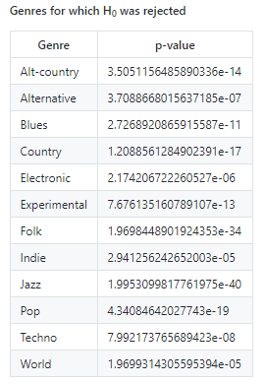
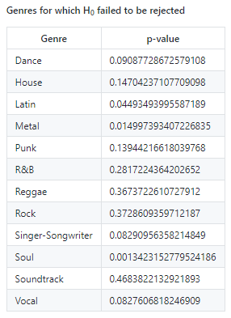
Results

Slide 8
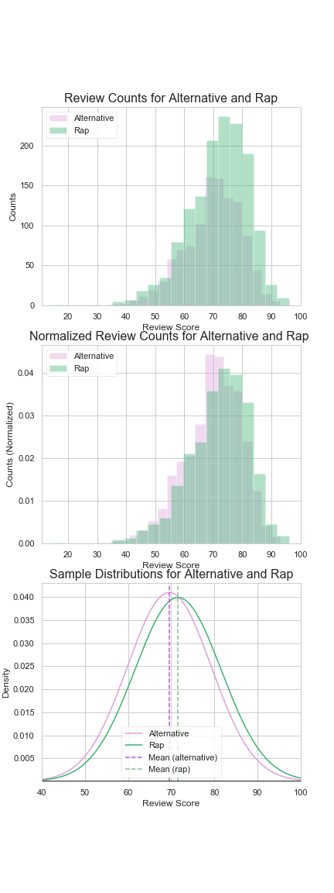
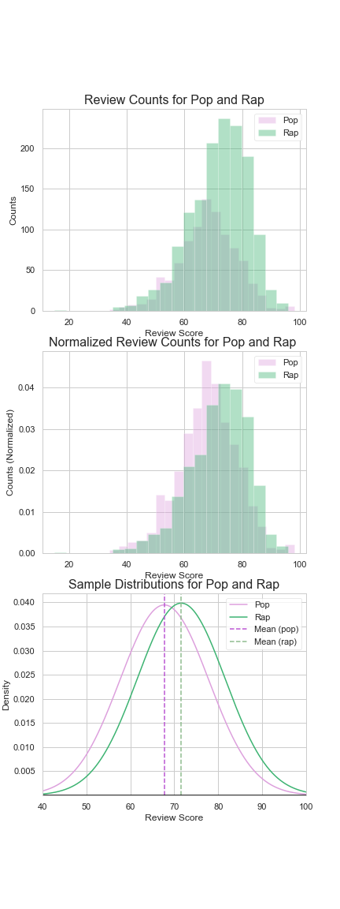

Slide 9
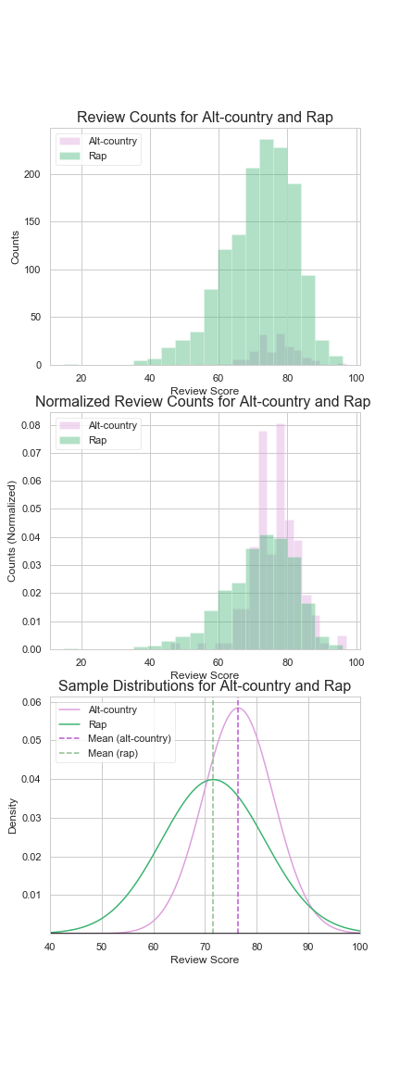
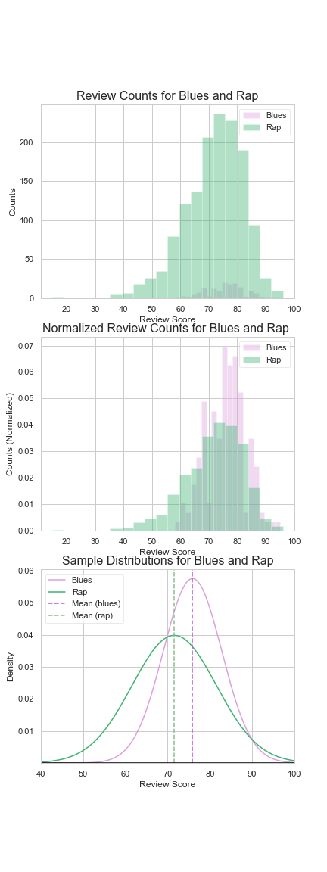
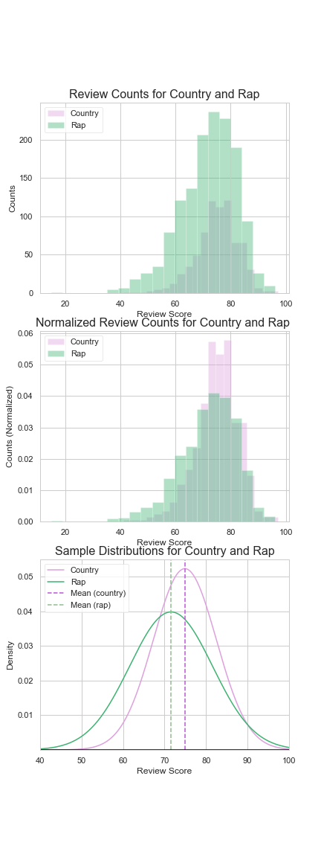
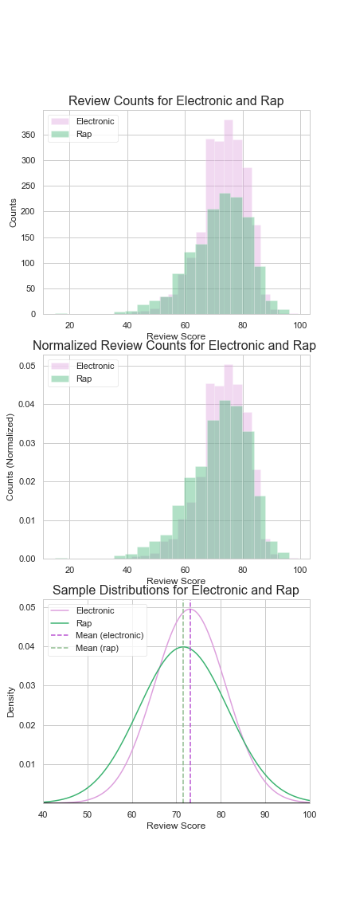


Slide 10
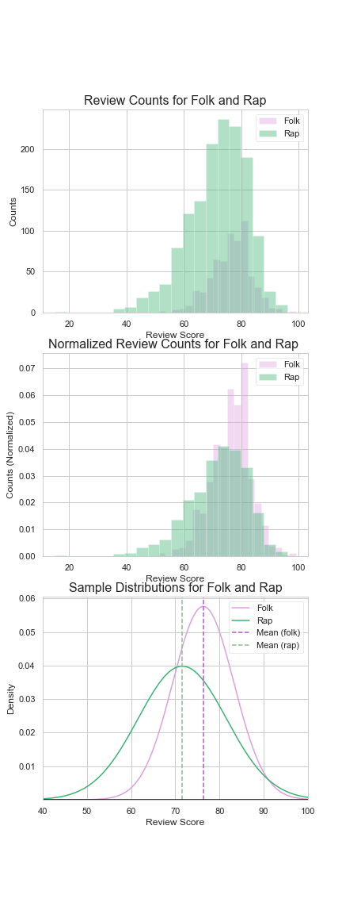
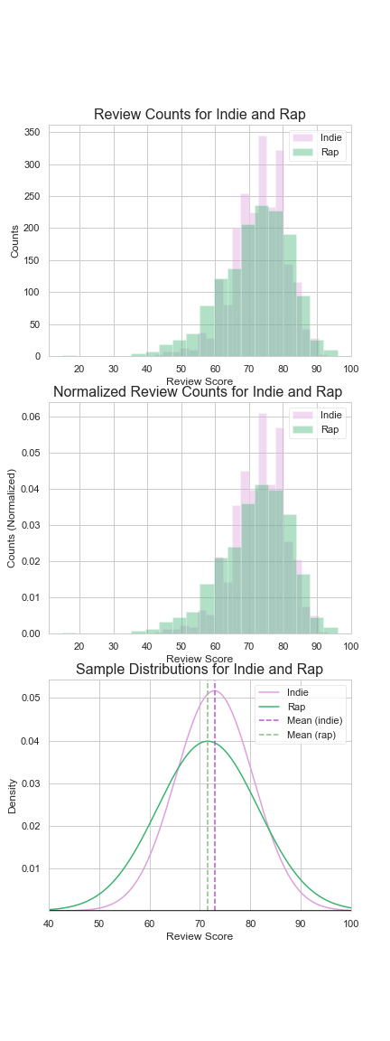
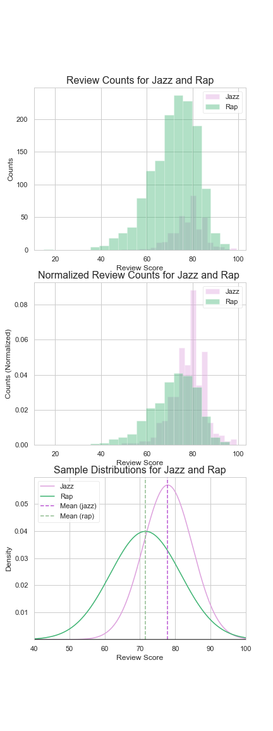

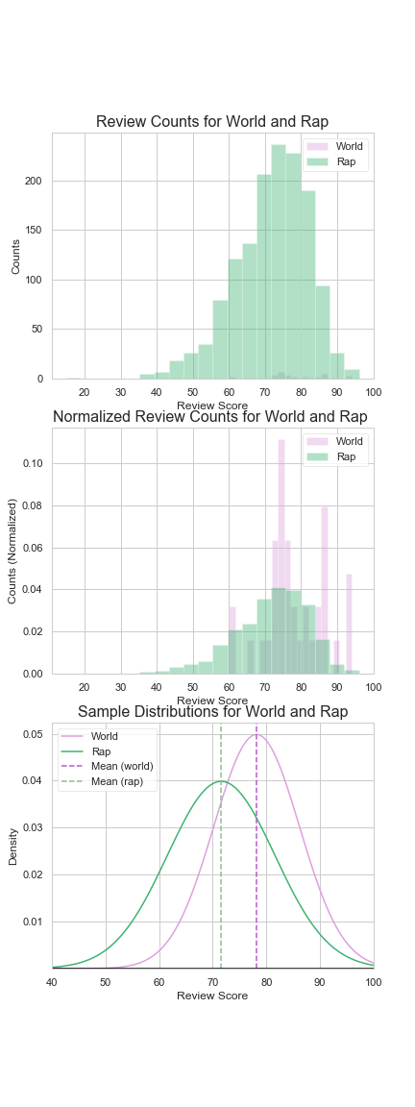

Slide 11
The question: who’s bad?

Slide 12

Thank You!
Email:
broderickturner92@gmail.com
Github:
www.github.com/unclebrod
LinkedIn:
www.linkedin.com/in/broderickturner

